Slide 1

Optimizing Crop Water Use: Predictive Modeling with Multi-Model Machine Learning Approach
Guide Name: Dr.Vetriselvi. T
Team:
Nitesh Jeganathan – 21BCE3745
Nikita Prashant Singh – 21BCE3725
Pratham Vidhani – 21BCI0378

Slide 2
Abstract
Importance of Water Management in Agriculture:
Vital for enhancing crop productivity and sustainability, especially in water-scarce regions.
Precision agriculture offers potential for optimizing water resource use.
Role of Machine Learning in Smart Irrigation:
Machine learning (ML) enables prediction and monitoring of crop water requirements based on environmental factors.
Traditional smart irrigation systems do not account for dynamic plant water needs during different growth phases.
Project Overview:
Several ML models, including neural networks, are applied to predict crop water needs.
Neural networks excel in capturing complex, non-linear relationships in large datasets.
Inputs for ML Models:
Environmental factors like temperature, humidity, and wind speed are used as inputs.
Penman-Monteith equation is utilized for calculating precise water needs.
Comparative Analysis of Models:
Comparison of neural networks with traditional ML algorithms for predicting water requirements.
Multi-model approach allows for comprehensive analysis of model performance.
Impact and Benefits:
Evaluation of model performance based on prediction accuracy of daily water requirements.
Findings support sustainable water usage, reduce waste, improve crop health, and facilitate data
driven decision-making in precision farming.

Slide 3
Literature Review

Slide 4
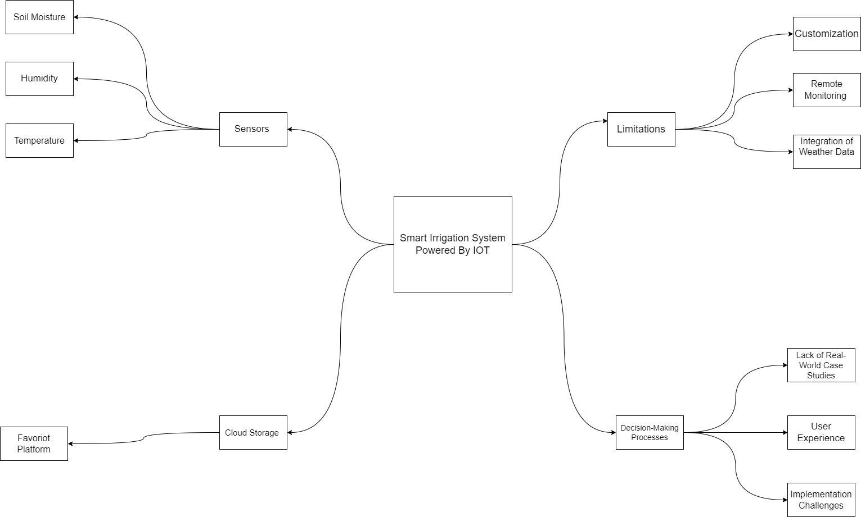
[1] Smart Irrigation System

Slide 5
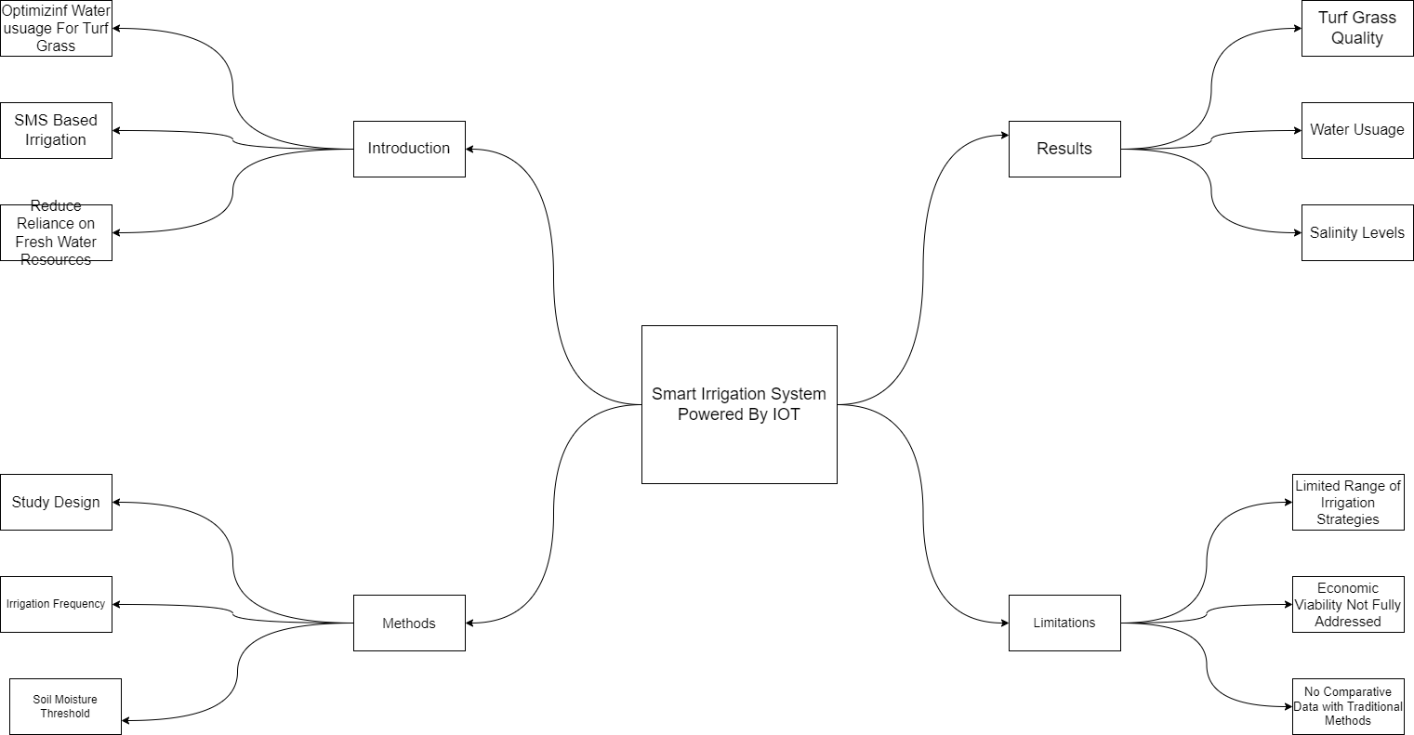
[2] Using a soil moisture sensor-based smart controller for autonomous irrigation management of hybrid bermudagrass with recycled water in coastal Southern California

Slide 6
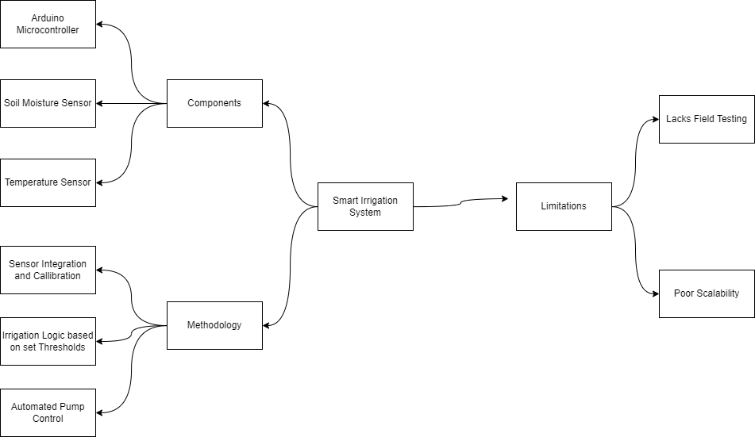
[3] Smart Irrigation System

Slide 7
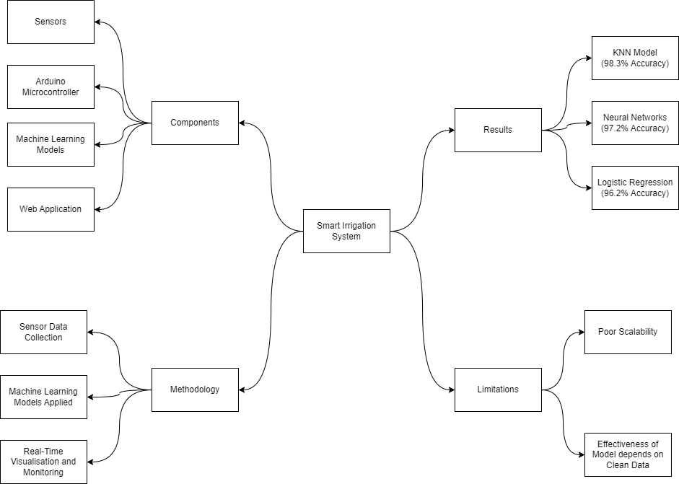
[4] Smart irrigation system based on IoT and machine learning

Slide 8
Research Gap
Significant gap in the consideration of crop-specific water requirements and variations in water demand across different growth phases.
Most studies focus on general optimization of water usage, leveraging IoT technology and automation, but fail to account for diverse water needs of different crop types.
Insufficient attention to how water requirements fluctuate based on the developmental stage of crops, which is crucial for ensuring optimal growth and yield.
Integration of soil moisture sensors, weather data, and automated irrigation systems shows promising results, but current approaches often apply uniform irrigation strategies.
Lack of adaptation to the unique needs of individual crops or adjustments for their growth phases reduces the potential for precise water management.
This limitation affects water conservation and crop productivity.
Lack of research on how smart irrigation systems can be tailored to specific agricultural environments where crop diversity is common.

Slide 9
Functional Requirements
Sensors
Raw Data from Sensors
Water Requirement Calculation
Predictive Modelling
Automated Irrigation
User Interface
Data Storage and Management
Manual Overridde

Slide 10
Non-Functional Requirements
Scalability
Reliability
Accuracy
Maintainability
Usability

Slide 11
Proposed Work
Development of a smart irrigation system that adjusts water delivery based on crop-specific needs and growth stages.
Addresses gaps in existing systems that use a one-size-fits-all irrigation approach.
Machine learning models will be developed to predict precise water requirements for each crop growth stage.
Dynamic irrigation scheduling system will adjust water usage based on crop growth and environmental data.
Focus on ensuring efficient water management and reducing waste
System will be tested in real-world conditions and compared with traditional irrigation methods.
Emphasis on measuring water savings and improvements in crop yield.

Slide 12
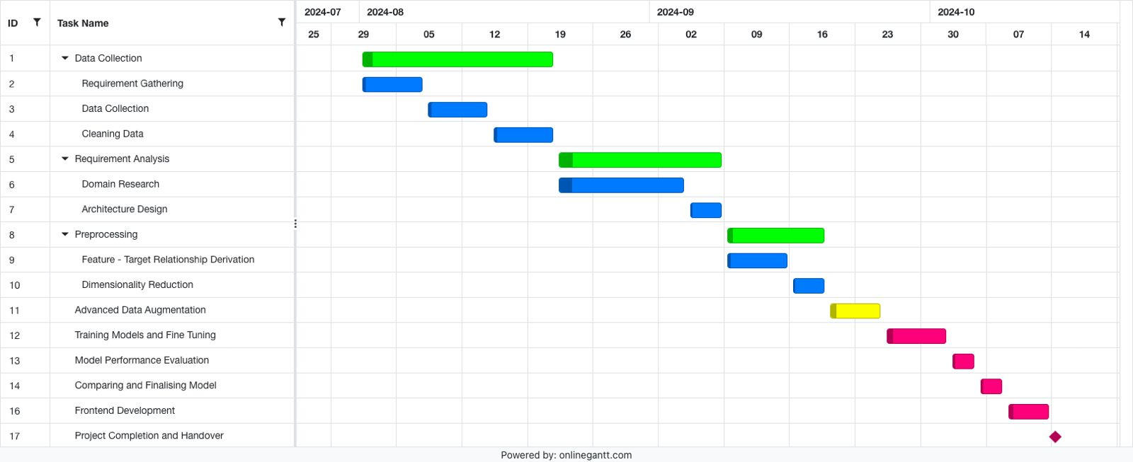
Gantt Chart

Slide 13
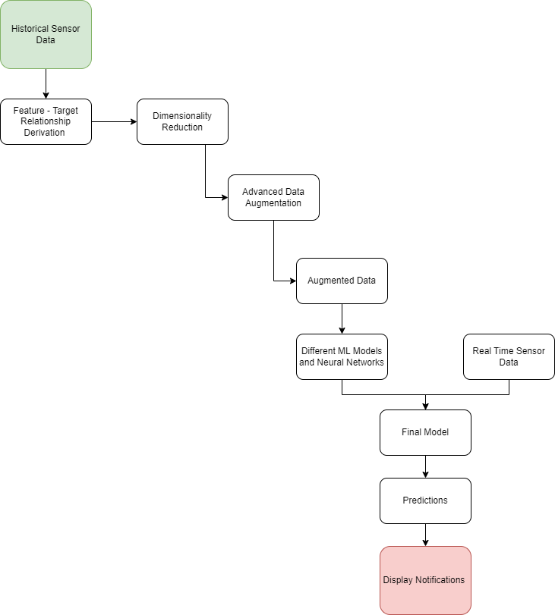
Architecture

Slide 14
Code Progress

Slide 15
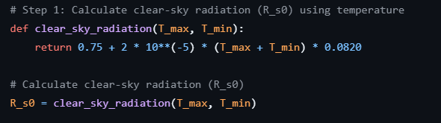
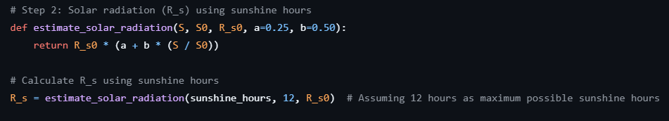
Clear-Sky Radiation (R_s0):
R_s0 = 0.75 + 2 × 10⁻⁵ × (T_max + T_min) × 0.0820 Where: - T_max = Maximum temperature (°C) - T_min = Minimum temperature (°C)
Solar Radiation (R_s):
R_s = R_s0 × (a + b × (S / S₀)) Where: - R_s0 = Clear-sky radiation - S = Actual sunshine hours - S₀ = Maximum possible sunshine hours (assumed 12 in the code) - a = 0.25, b = 0.50 (constants)

Slide 16

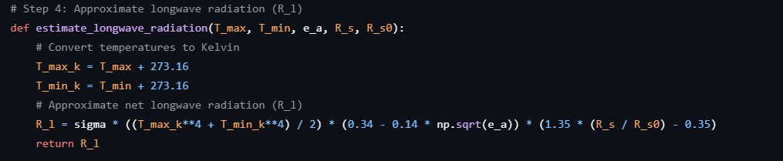
Net Shortwave Radiation (R_sn):
R_sn = (1 - albedo) × R_s Where: - albedo = 0.23 (for agricultural land) - R_s = Solar radiation
Net Longwave Radiation (R_l):
R_l = σ × ((T_maxₖ⁴ + T_minₖ⁴) / 2) × (0.34 - 0.14 × √e_a) × (1.35 × (R_s / R_s0) - 0.35) Where: - σ = 4.903 × 10⁻⁹ (Stefan-Boltzmann constant in MJ/m²/day/K⁴) - T_maxₖ, T_minₖ = Maximum and minimum temperatures in Kelvin - e_a = Actual vapor pressure - R_s = Solar radiation - R_s0 = Clear-sky radiation

Slide 17

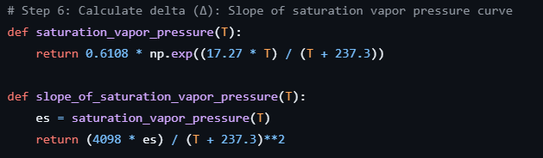
Saturation Vapor Pressure (es):
es = 0.6108 × exp((17.27 × T) / (T + 237.3)) Where: - T = Temperature (°C)
Slope of Saturation Vapor Pressure Curve (Δ):
Δ = (4098 × es) / (T + 237.3)² Where: - es = Saturation vapor pressure - T = Temperature (°C)

Slide 18

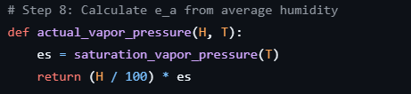
Actual Vapor Pressure (e_a):
e_a = (H / 100) × es Where: - H = Humidity (%)
- es = Saturation vapor pressure at temperature T
Net Radiation (R_n):
R_n = R_sn - R_l Where: - R_sn = Net shortwave radiation - R_l = Net longwave radiation

Slide 19
Penman-Monteith Equation (E_t0):
E_t0 = (0.408 × Δ × (R_n - G) + γ × (900 / (T + 273)) × u × (es - e_a)) / (Δ + γ × (1 + 0.34 × u)) Where: - R_n = Net radiation - G = Soil heat flux (assumed 0 in daily calculations) - Δ = Slope of the vapor pressure curve - γ = 0.066 (psychrometric constant in kPa/°C) - T = Temperature (°C) - u = Wind speed (m/s) - es = Saturation vapor pressure - e_a = Actual vapor pressure

Slide 20
Upcoming Development Phase
Challenge of Limited Real-Time Data: In many scenarios, the amount of real-time data available is insufficient for producing accurate and reliable results, especially in complex applications like precision agriculture.
Need for Advanced Data Augmentation: To address this data scarcity, advanced data augmentation techniques are employed to artificially expand the dataset, providing more comprehensive inputs for machine learning models.
Use of Genetic Algorithms: Genetic algorithms, inspired by the process of natural selection, are applied to generate synthetic data. These algorithms help create new data points that mimic the patterns and variations found in real-time data.
Multiplying Data for Enhanced Accuracy: By multiplying the available real-time data, genetic algorithms increase the volume and diversity of the dataset, improving the ability of models to make accurate predictions.
Improved Model Performance: The augmented dataset enables machine learning models to perform more robustly, especially in cases where real-time data is sparse, leading to more precise outcomes.
Impact on Precision Agriculture: In precision agriculture, this approach enhances the accuracy of water requirement predictions and decision-making processes, leading to more efficient resource management and improved crop productivity.
Real-World Benefits: The combination of augmented data and genetic algorithms supports better real-world results, reducing dependency on scarce real-time data and enabling more scalable, data-driven solutions.

Slide 21
Thank you

